Slide 1
Interactive Systems Date Range Picker Application
Intermediate Presentation
Peter Kofi Adomire
Ekas Preet Singh
Winter Semester(2021/2022)

Slide 2
Introduction
Statement of the Problem:
Some date range applications are confusing.
Spending less time in selecting a date range on an application.

Slide 3
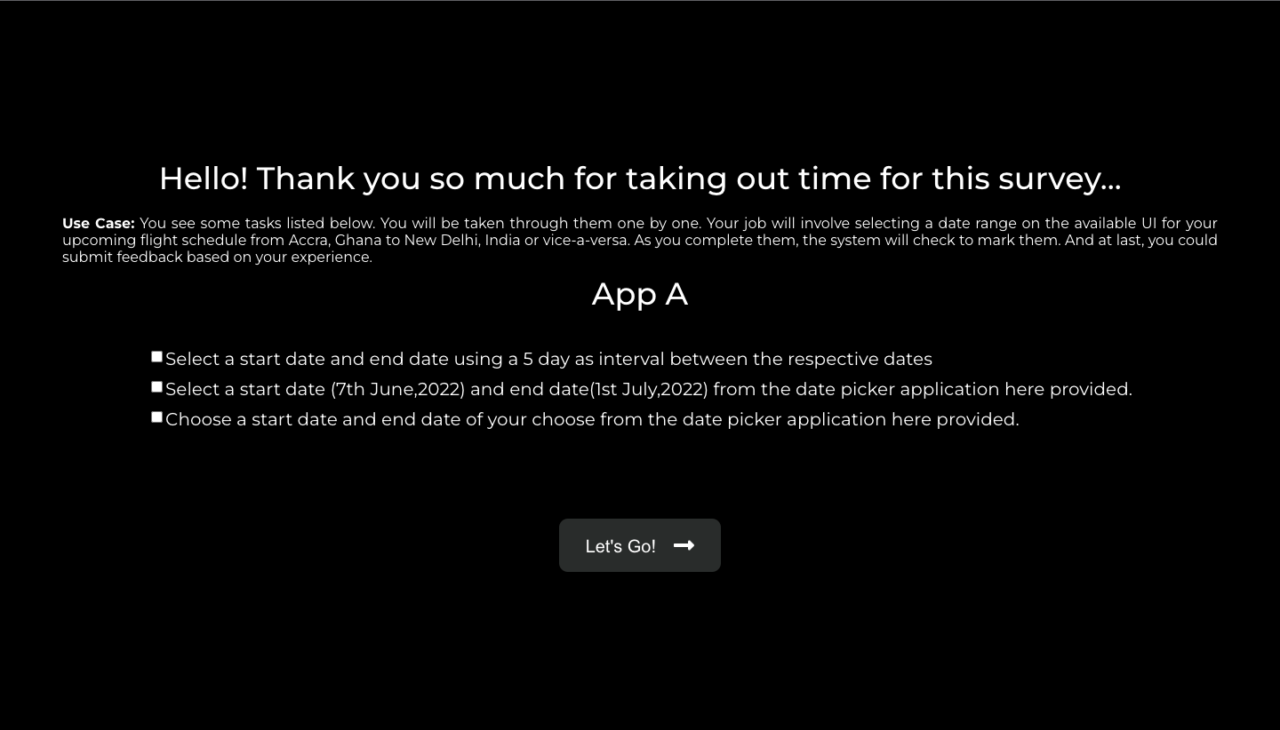
State of the Art

Slide 4
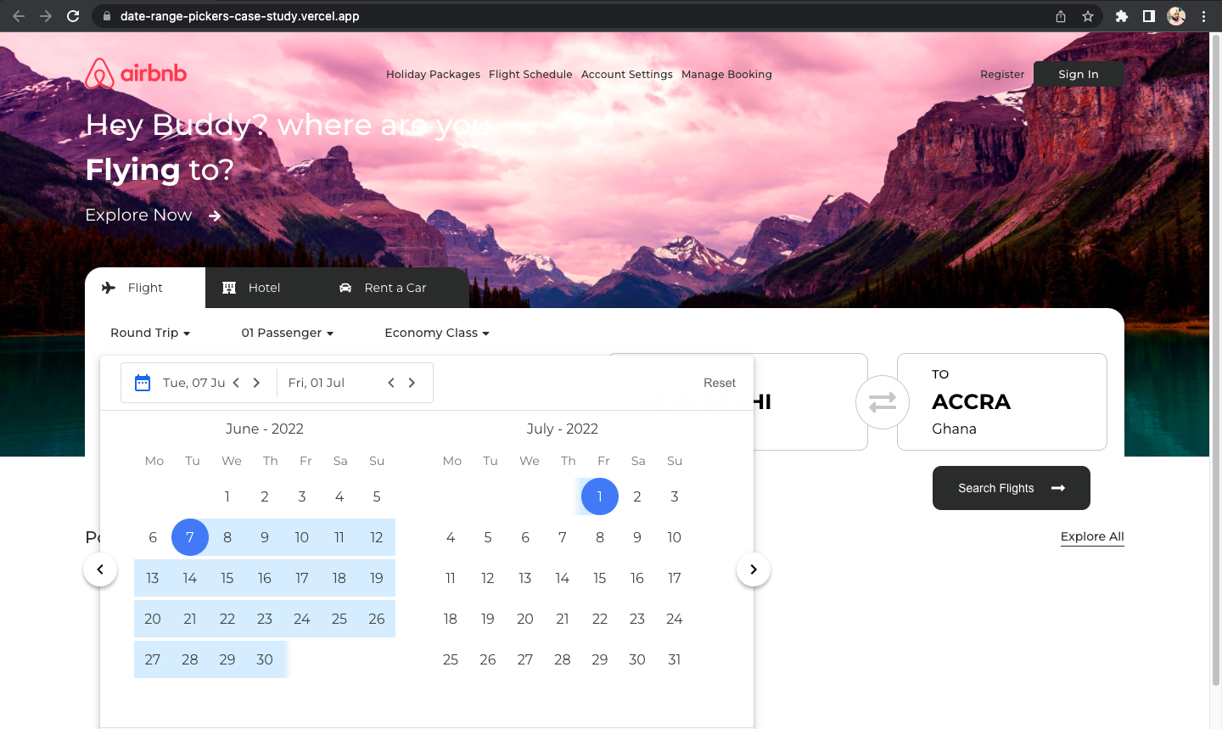
Proposal - App A

Slide 5
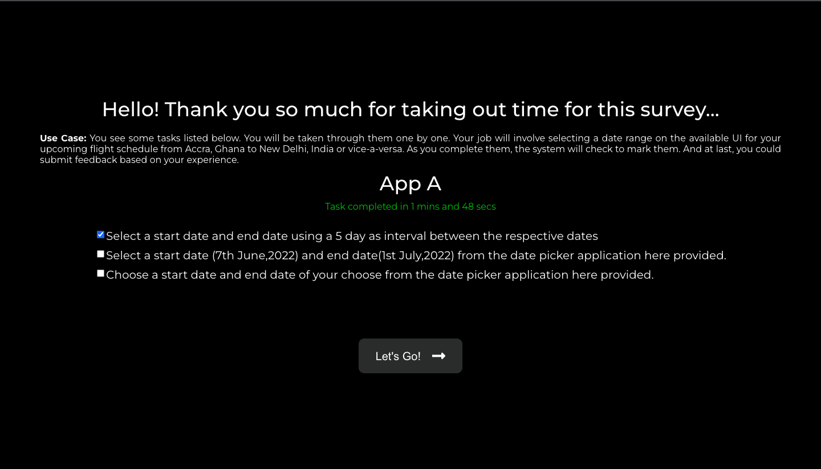

Slide 6
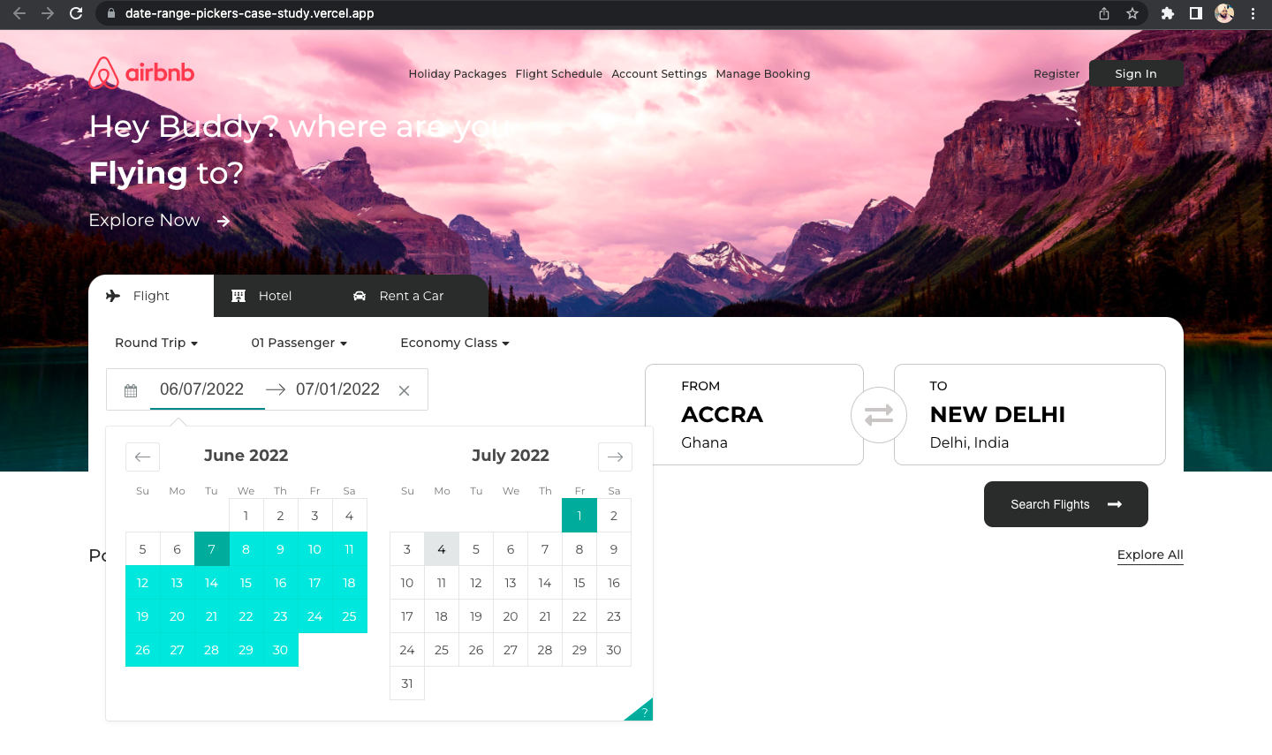
Proposal - App B

Slide 7
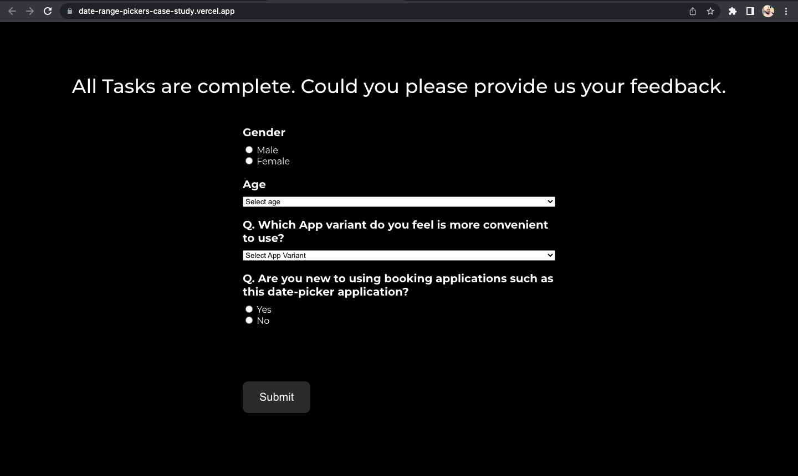
Questionnaire

Slide 8
Proposal
Postulation: App B present a better selection date range system

Slide 9
Hypothesis
H₁: App A has a better information on dates selected and doesn’t require any special separation characters
H₂: Which application (App A/App B) do you spend less than 2 minutes in interacting with?

Slide 10
Variables
Independent Variables:
App A and App B have different UI’s or design.
App A support international date format.
App B support direct input of dates using special separation characters.
Dependent Variable:
Subjective: App A clearly distinguish dates by showing name of the month.
Subjective: Choice of App A or App B.
Objective: Time of interaction with each App.

Slide 11
Methodology
Users will perform 3 separate tasks.
Feedback from questionnaires from users.
Task was timed within 2 mins.

Slide 12
Live Demo

